Slide 1

PlaatEnergy (Energy Data Logger)
Ing. W.B.J. van der Plaat
(Software Architect)

Slide 2

Question
How many energy is my house using daily?
How many gas is my heater using daily?
How many energy is my solar system deliver daily?

Slide 3

Idea
Lets create an application which measures everything
Records every minute energy and gas usage
Records every minute solar energy delivered
Records every minute environment temperature, humidity and pressure
Create User friendly Web GUI
Use low cost low energy hardware

Slide 4
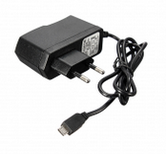
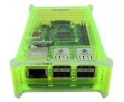

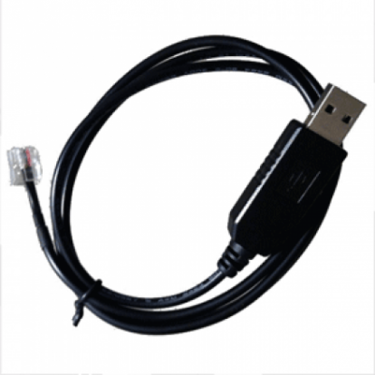
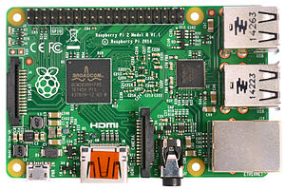
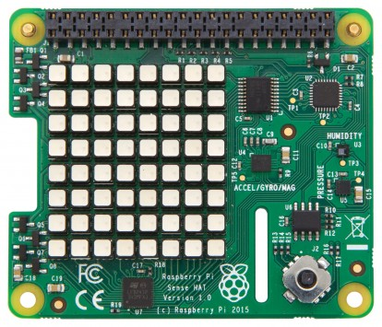
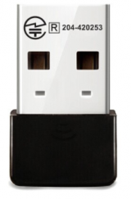
Used Hardware
Raspberry Pi 2B
USB to P1 Cable
Micro SD card
USB power supply
Raspberry Pi Case
USB Wifi Dongle
Pi Sense Hat (optional)

Slide 5

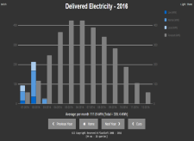


Hardware view – Basic configuration 1
P1 cable
Digital Energy
Meter
Raspberry Pi
PlaatEnergy
Sense Hat (Pi)
HDMI cable
USB cable
USB cable

Slide 6

Hardware view – Basic configuration 2
P1 cable
Digital Energy
Meter
Bluetooth
Digital Gas
Meter
Raspberry Pi
PlaatEnergy
Sense Hat (Pi)
Ethernet
or
Wifi
Router
Intranet
PlaatEnergy
Slide on attach
monitor

Slide 7
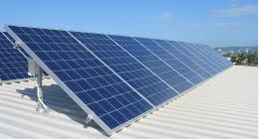
Hardware view – Basic configuration 3
Digital Energy
Meter
P1 cable
Solar
Converter
Raspberry Pi
PlaatEnergy
Sense Hat (Pi)
Ethernet
or
Wifi
Router
Intranet

Slide 8
Hardware view – Basic configuration 4
P1 cable
Digital Energy
Meter
Bluetooth
Digital Gas
Meter
Solar
Converter
PlaatEnergy
Secure access on internet
Raspberry Pi
PlaatEnergy
Sense Hat (Pi)
Wifi
Ethernet
or
Wifi
Router
Intranet
HDMI cable
Router
PlaatEnergy
Slide on attach
monitor
Internet

Slide 9
Hardware view – Complex configuration
P1 cable
Energy
Meter
Bluetooth
Gas
Meter
Solar
Converter
Solar
Converter
Solar
Converter
Raspberry Pi
PlaatEnergy
Sense Hat (Pi)
Wifi
Wifi
Wifi
Router
Wifi
Intranet
HDMI kabel
PlaatEnergy
Reachable by
internet
PlaatEnergy
slide show
via
monitor
Router
Internet

Slide 10
PlaatEnergy Software Architecture
Google Charts
Weather Service
json
Presentation Layer
php/css/js
Data Aggregation algorithm
sql
Database Layer
sql
Solar Converter
Sensor Script
Energy Meter
Sensor Script
Environment
Sensor Script
Display
Sensor Script
php/python
Operating System (Linux Debian)
unix

Slide 11
PlaatEnergy Key features
Measure each device every minute
User friendly user web interface
Show real-time, historical and forecast data
Show financial data
Support measurement corrections
Export measure data to CSV and SQL
Open Source and free to use!
Upgrade detection + automatic data model patching
Secure access to Web GUI and settings

Slide 12
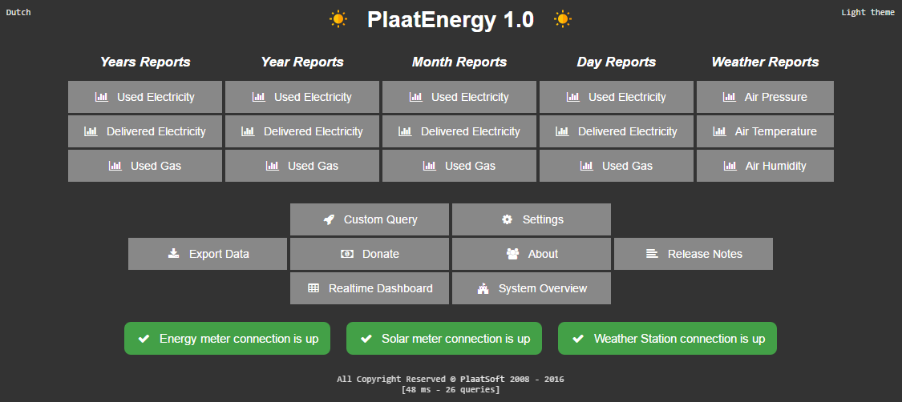

Slide 13
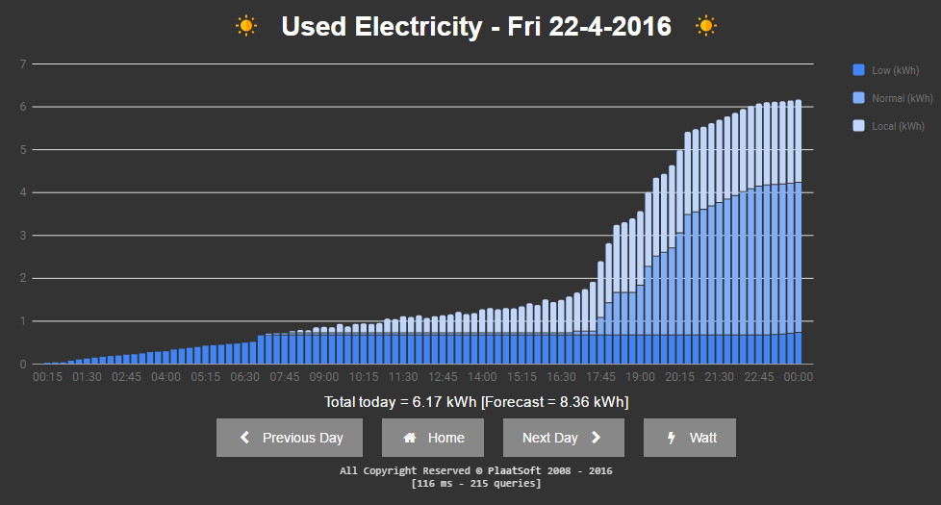

Slide 14
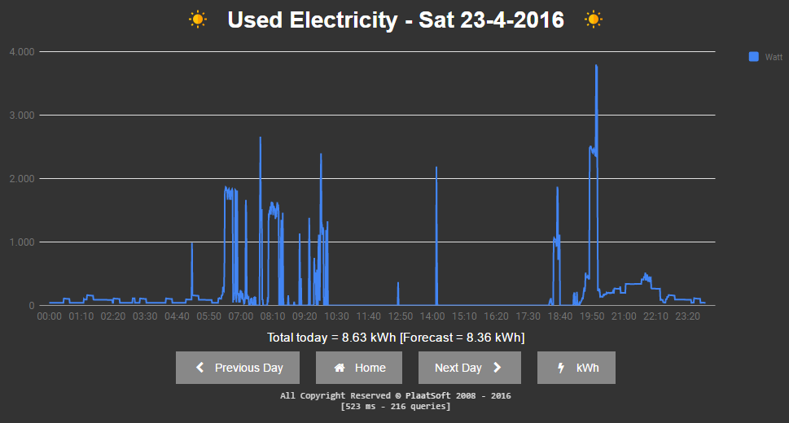

Slide 15
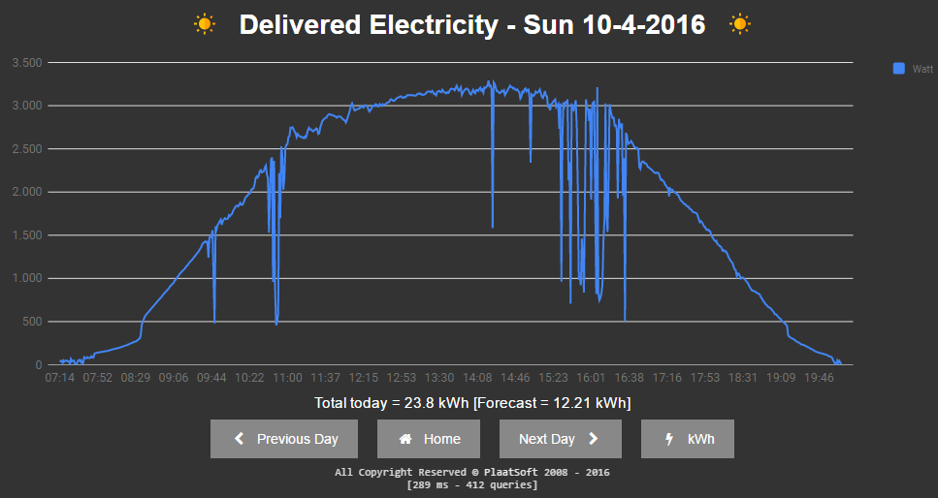

Slide 16
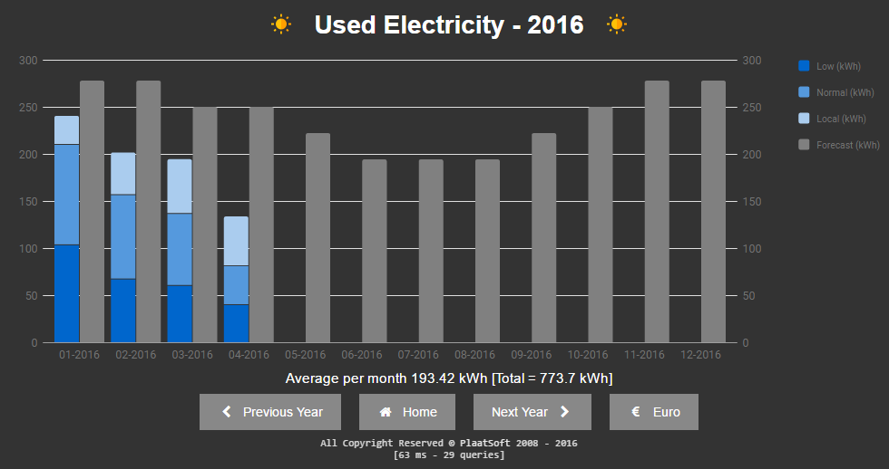

Slide 17
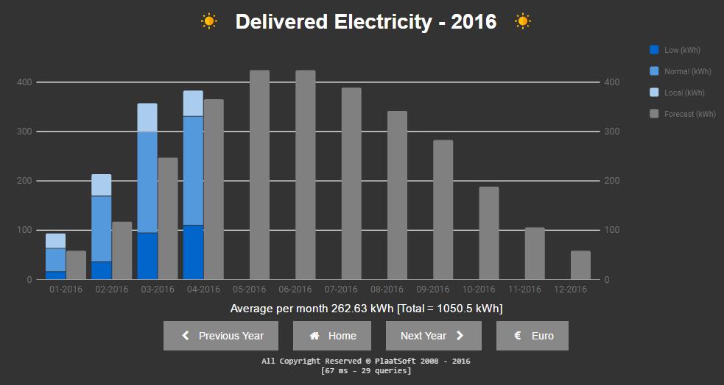

Slide 18
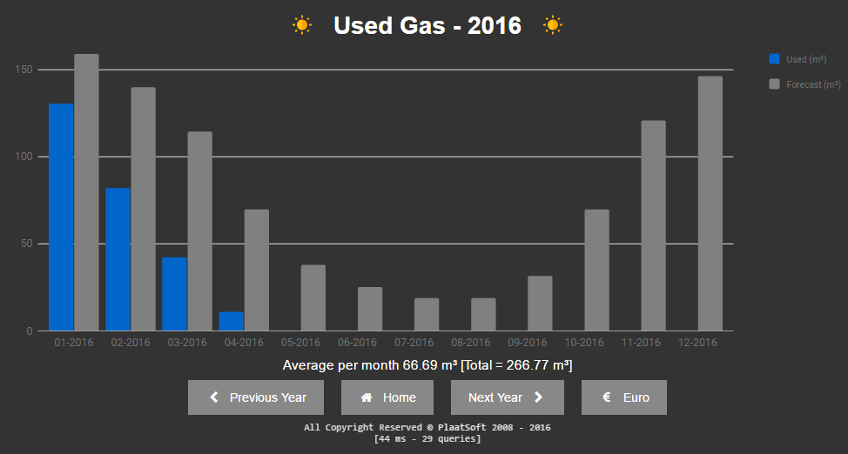

Slide 19
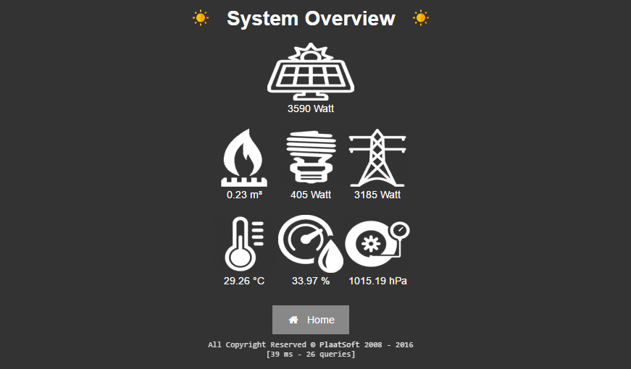

Slide 20
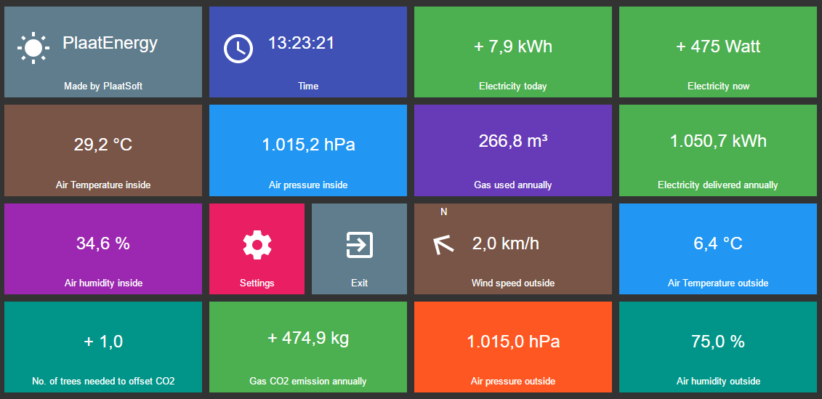

Slide 21
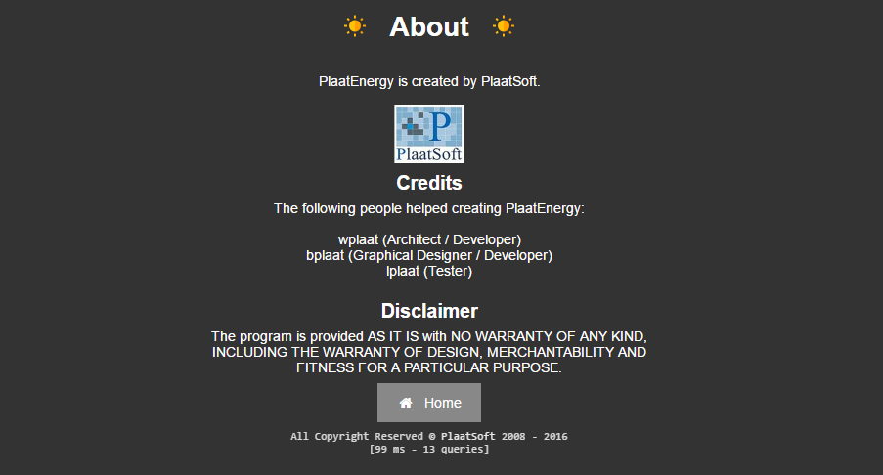

Slide 22
Conclusion
My energy / gas us is dropped with 25% / 50% because I am more aware.
PlaatEnergy is downloaded ca. 100 times now
“Customers” sending great feedback back ☺
Oostpoort church in Gouda is going to use my software soon. Project is on the move ☺

Slide 23
Feature Plans
Add Google Nest product support
Nest thermostat. Control my thermostat remote
Nest Protect. Receive notification when gas and/or fire is detected
Add Philips Hue product support
Control lights in my house
New idea’s are welcome!

Slide 24


